Slide 1
2025 Findings

Slide 2
Housekeeping notes
Please use the chat to share your comments and questions—we’ll have time for Q&A at the end of the presentation
Closed captioning is available. To activate it, click the CC icon in your Zoom toolbar and select “Show Captions”
We’re recording today’s briefing, and we’ll share both the recording and the slides after the session
For more information about Pulse, visit copulsepoll.org

Slide 3
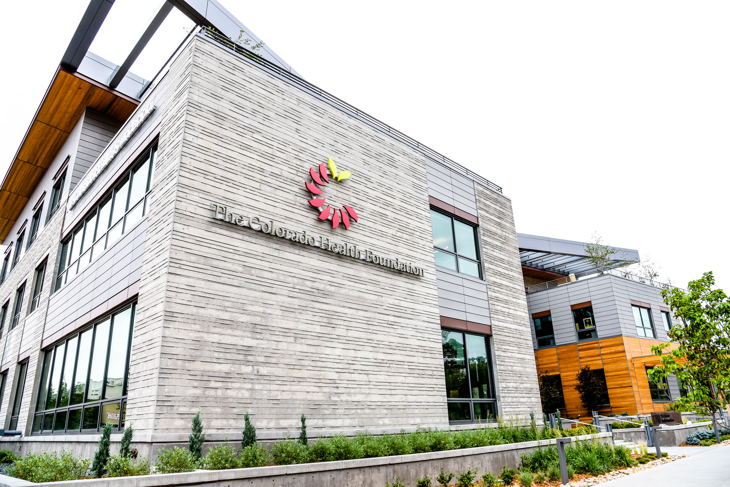
About The Colorado Health Foundation
CHF is a statewide philanthropic organization that champions the overall health and well-being of every Coloradan
We do this by advocating for and investing in solutions and policies that drive health equity and racial justice.
We collaborate with organizations and communities across Colorado to break down the many systemic barriers to achieving health and well-being.
We believe that health and well-being can be in reach for everyone.

Slide 4
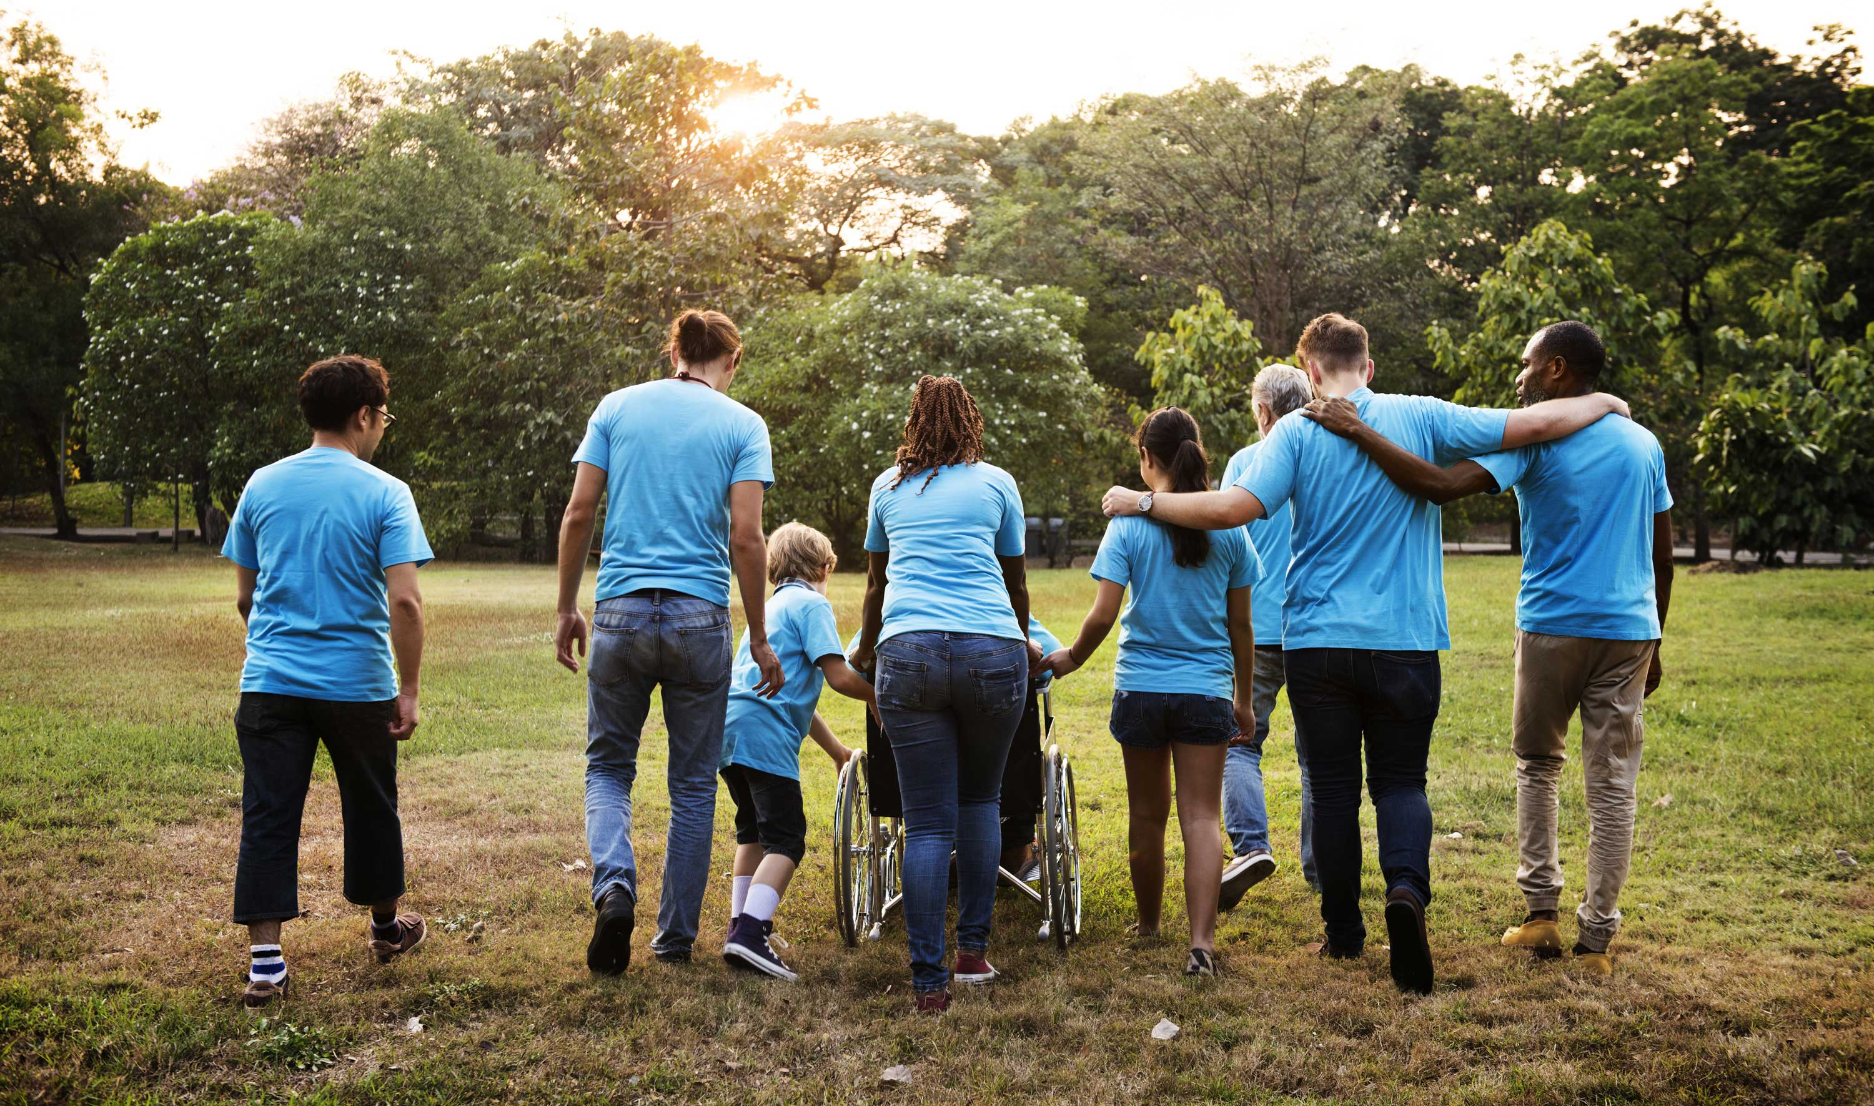
About Pulse
Launched in 2020, it’s an annual poll that takes the pulse of Coloradans on a range of issues that impact health and well-being.
We share all the results with policymakers, community leaders and the media.
Pulse helps us hear from people beyond our usual circles, giving us a deeper understanding of what Coloradans are experiencing.
As part of our commitment to racial justice, we oversample African Americans, Asian Americans and Pacific Islanders, and Native Americans to ensure their voices are represented in the data.

Slide 5





Survey Specifics and Methodology
(Not All Results Will Sum to 100% Due to Rounding)
Dates | April 19-May 18, 2025
Bipartisan Research Team | FM3 Research (D) and New Bridge Strategy (R)
Survey Type | Dual-mode Phone and Online Survey of Adult Coloradans
Research Population | 2,333 Coloradans including oversamples of Black/African-American, American Indian/Alaska Native , and Asian-American Coloradans, as well as residents of Morgan County
Margin of Sampling Error | ±3.07% at the 95% Confidence Level
Contact Methods
Data Collection Modes
Comparison Surveys | Pulse polls fielded in 2020-2024
Survey Languages | English and Spanish
Telephone
Calls
Email
Invitations
Text
Invitations
Telephone
Interviews
Online
Interviews

Slide 6



How We Reach People
Contact Methods
Telephone
Calls
Email
Invitations
Text
Invitations
Data Collection Modes
Telephone
Interviews
Online
Interviews

Slide 7
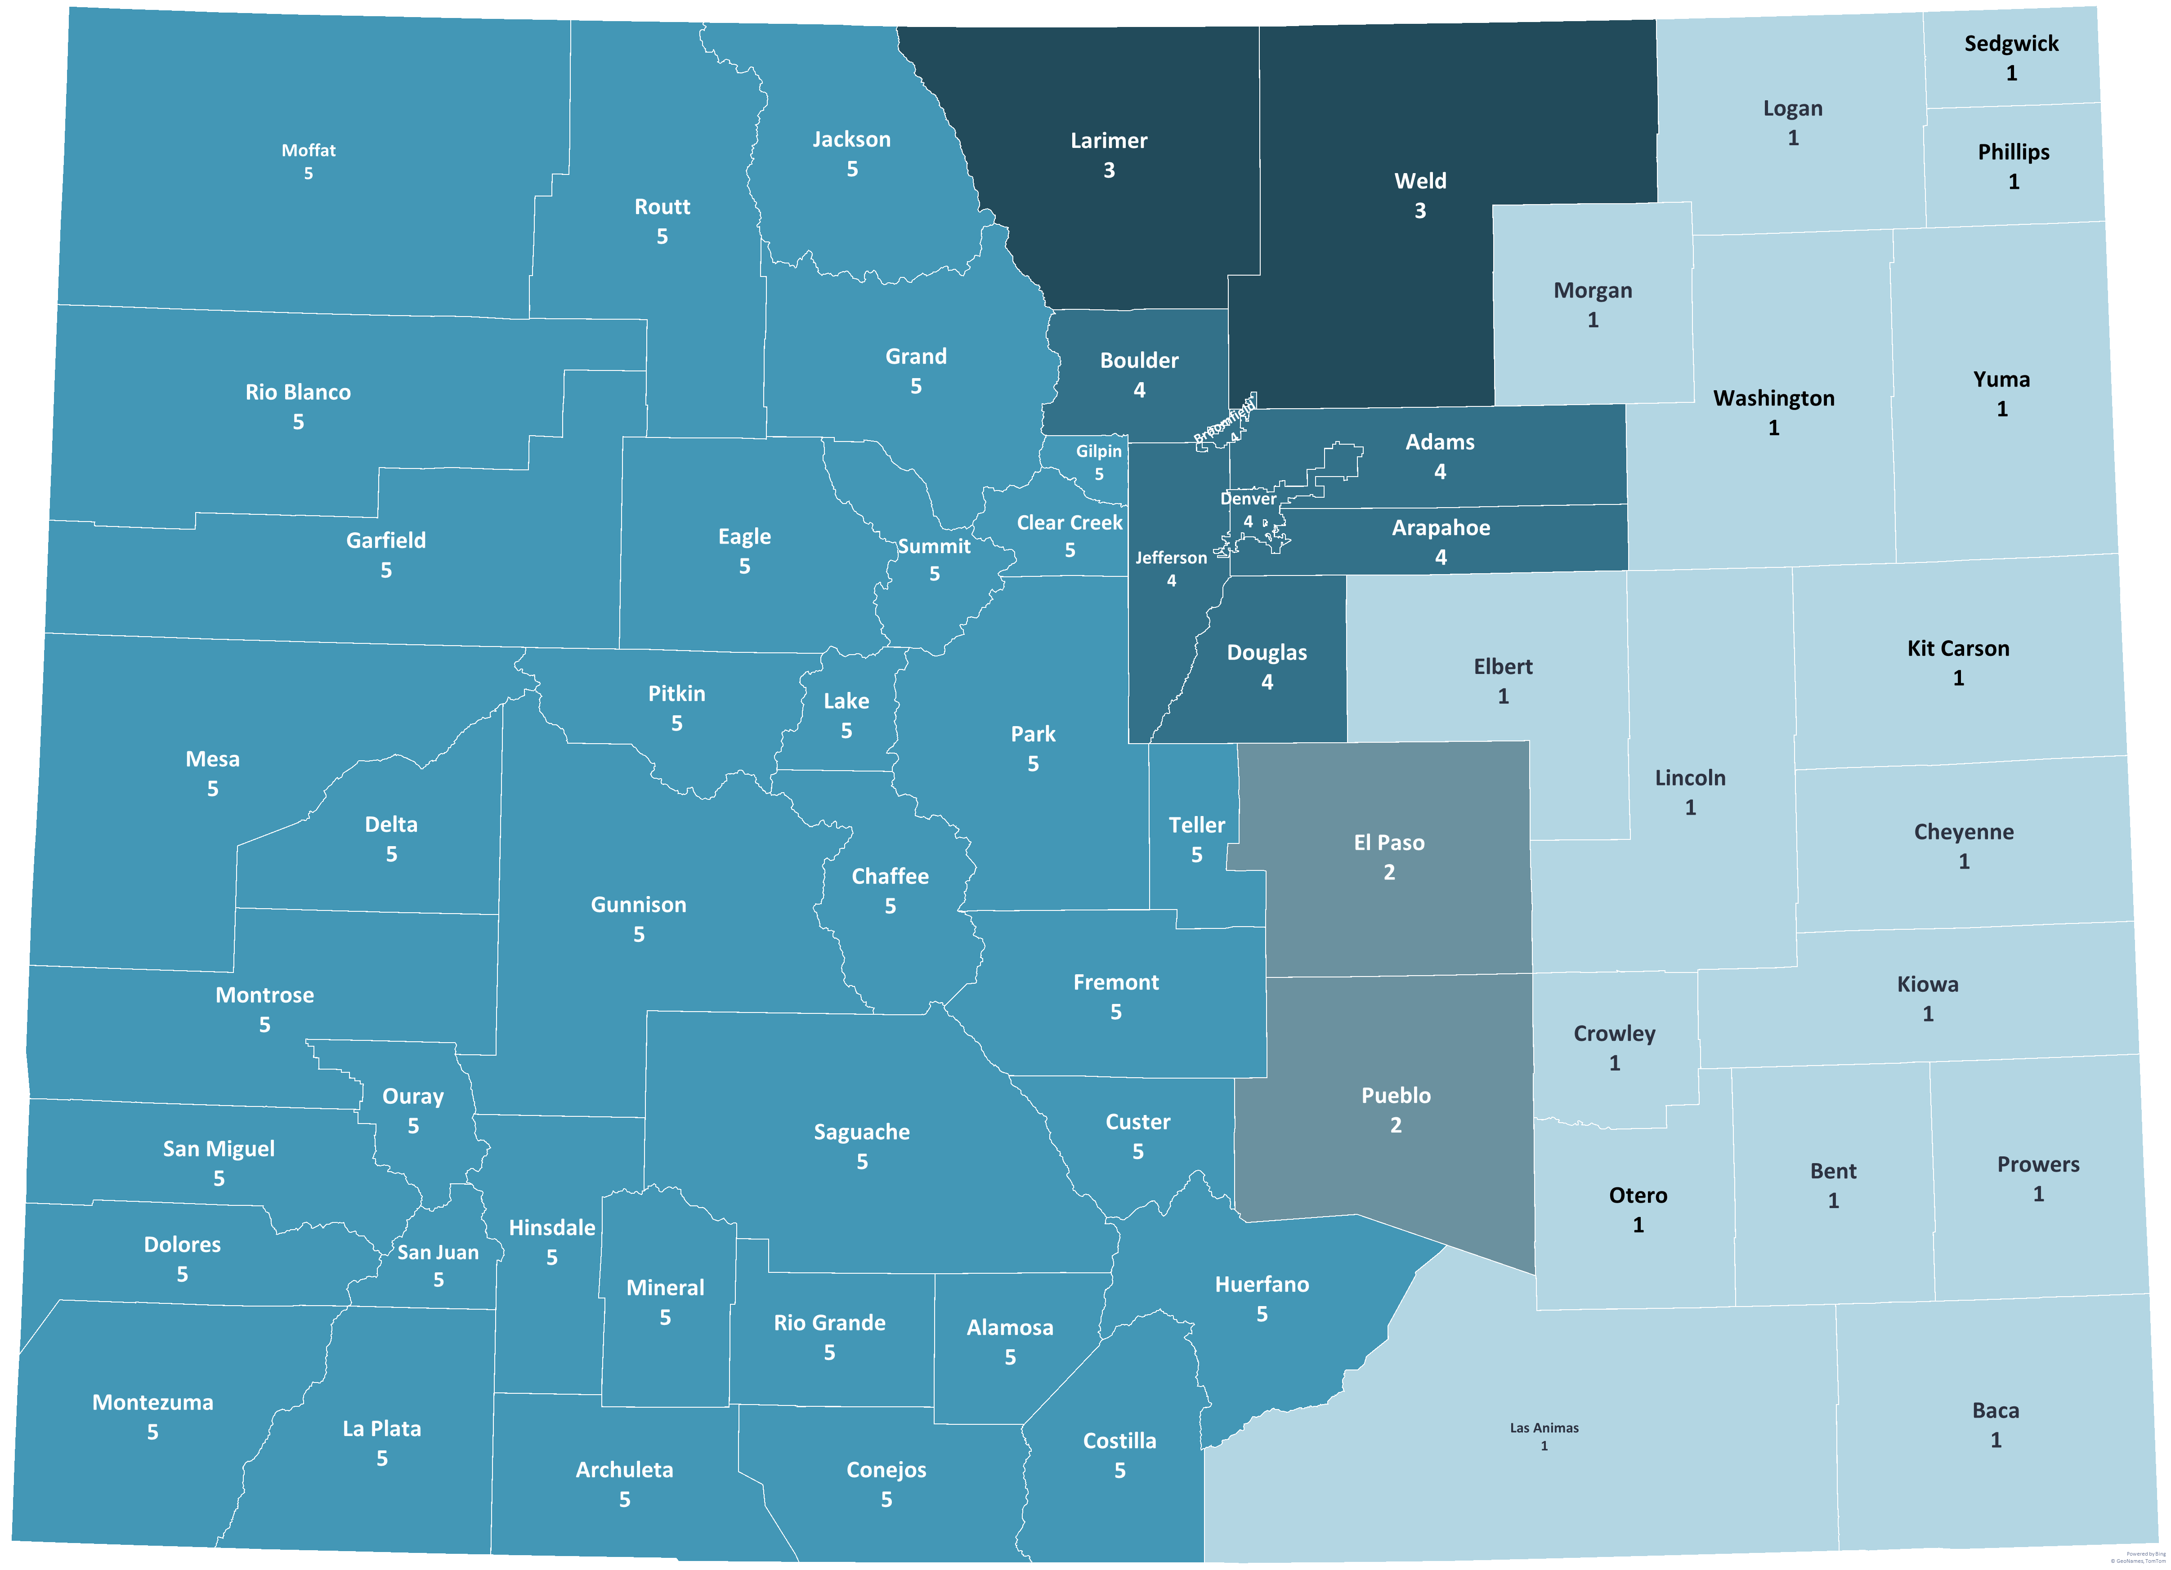
Colorado Region Map
 | Eastern Plains (1) | 2%
 | Colorado Springs (2) | 15%
 | Larimer Weld (3) | 12%
 | Denver Metro (4) | 56%
 | Western Slope (5) | 13%

Slide 9
We continue to see most Coloradans saying they have experienced mental health strain in the past year.
Q25. In the last year, have you experienced mental health strain such as anxiety, depression, loneliness, or stress?
(% Yes)
Demographic Groups Most Likely to Have Experienced Anxiety, Depression, Loneliness or Stress | %
Other Living Situations (Not renting or owning home) | 78%
Unemployed | 78%
Liberals | 73%
Women Ages 18-49 | 73%
LGBTQ+ | 73%
Independents Ages 18-49 | 71%
Liberal Democrats | 71%
Democrats Ages 18-49 | 71%
Rent from Company | 71%
Asian/Pacific Islander | 71%
Ages 30-39 | 70%
Renters | 70%
HH Income <$30,000 | 70%

Slide 10
Coloradans report that politics has contributed the most to mental health strain – more than even financial issues.
Q26. And which of the following contributes the most to your mental health strain:
(Open-ended; Asked only of those who have experienced mental health strain; n=1,298)

Slide 11
Partisan differences in causes of mental health strain are minimal.
Q26. And which of the following contributes the most to your mental health strain:
(Open-ended; Asked only of those who have experienced mental health strain; n=1,298)
Mental Health Strain Contributor | All | Party
 |  | Democrats | Independents | Republicans
Political issues | 32% | 34% | 34% | 27%
Financial issues | 29% | 30% | 26% | 31%
Family or relationship issues | 15% | 15% | 12% | 19%
Workplace issues | 8% | 8% | 9% | 8%
Experiencing unfair treatment from others because of some aspect of your identity | 2% | 1% | 3% | 3%

Slide 12
More affluent Coloradans experience more strain from politics; less affluent ones suffer strain from financial issues.
Q26. And which of the following contributes the most to your mental health strain:
(Open-ended; Asked only of those who have experienced mental health strain; n=1,298)
Mental Health Strain Contributor | All | Household Income |  |  |  |  |  | Residence
 |  | <$30,000 | $30,000-$50,000 | $50,000-$75,000 | $75,000-$100,000 | $100,000-$150,000 | $150,000+ | Home-owners | Renters
Political issues | 32% | 17% | 25% | 22% | 25% | 46% | 37% | 35% | 27%
Financial issues | 29% | 45% | 41% | 47% | 31% | 21% | 18% | 23% | 33%
Family or relationship issues | 15% | 12% | 15% | 8% | 14% | 13% | 19% | 18% | 10%
Workplace issues | 8% | 0% | 8% | 5% | 15% | 7% | 10% | 8% | 12%
Experiencing unfair treatment from others because of some aspect of your identity | 2% | 3% | 4% | 2% | 1% | 2% | 3% | 2% | 3%

Slide 13
Coloradans who report experiencing mental health strain express more concern about a range of issues – notably mental health, climate change, and mistreatment of immigrants.
Q15. Please consider the following issues that some people suggest are problems facing Colorado. Please indicate whether you think it is an extremely serious problem, a very serious problem, a somewhat serious problem, or not too serious a problem for residents of Colorado.
(% Extremely/Very Serious Problem)
Problem | All | Mental Health Strain
 |  | Experienced | Has Not Experienced
The rising cost of living | 89% | 95% | 83%
The cost of housing | 84% | 86% | 81%
The cost of healthcare | 75% | 79% | 68%
Homelessness | 74% | 74% | 74%
Drug overdoses | 65% | 65% | 66%
Mental health | 59% | 66% | 51%
Jobs and the economy | 58% | 62% | 53%
Wildfires or other natural disasters | 56% | 63% | 50%
Crime, in general | 55% | 48% | 67%
Drug and alcohol abuse | 52% | 51% | 56%
Climate change | 51% | 58% | 41%
Illegal immigration | 49% | 40% | 63%
Restrictions on reproductive rights | 43% | 46% | 38%
Hunger | 41% | 46% | 35%
Gun violence | 41% | 47% | 34%
Mistreatment of immigrants | 37% | 44% | 29%
Police violence and misconduct | 29% | 34% | 21%
Racial bias and discrimination | 27% | 34% | 20%
Crime, in your neighborhood | 24% | 22% | 28%
Split Sample

Slide 14
One-in-five Coloradans have postponed mental health care in the last year.
Q23d. In the last 12 months, have you experienced any of the following? Postponed mental health care
(% Yes)
Demographic Groups Most Likely to Have Postponed Mental Health Care | %
Unemployed | 50%
Rent from an Individual | 48%
Rent from Friends/Family | 42%
Renters | 41%
HH Income <$30,000 | 39%
Rent from Company | 37%
Ages 18-29 | 36%
LGBTQ+ | 36%
American Indian/Alaska Native | 36%
Women Ages 18-49 | 35%
Democrats Ages 18-49 | 35%
Have Other/No Insurance | 35%
Pueblo County | 35%
Ages 18-39 | 33%
Liberal Democrats | 32%
Other Living Situations | 32%

Slide 16





A significant proportion of Coloradans have experienced financial challenges in the last year.
Q23b. In the last 12 months, have you experienced any of the following?
(% Yes)
30% Postponed medical care | 33% Postponed dental care | 19% Had work hours cut back or wages reduced | 8% Been laid off | 12% Skipped meals because you couldn’t afford food

Slide 17
The proportion reporting postponing medical care in the last year has declined.
Q23b. In the last 12 months, have you experienced any of the following? Postponed medical care
(% Yes)
Demographic Groups Most Likely to Have Postponed Medical Care | %
Have Other/No Insurance | 55%
Unemployed | 55%
HH Income <$30,000 | 51%
American Indian/Alaska Native | 51%
Other Living Situations | 50%
Rent from Friends/Family | 50%
Rent from an Individual | 49%
Renters | 48%
Rent from Company | 48%
Caregivers | 45%
Pueblo County | 45%
*Combined with Dental Care Before 2025

Slide 18
The same is true for postponing dental care.
Q23c. In the last 12 months, have you experienced any of the following? Postponed dental care
(% Yes)
Demographic Groups Most Likely to Have Postponed Dental Care | %
HH Income <$30,000 | 61%
Unemployed | 59%
Rent from an Individual | 53%
Have Other/No Insurance | 52%
Rent from Company | 51%
Renters | 50%
Other Living Situations | 49%
LGBTQ+ | 47%
Caregivers | 47%
Larimer County | 46%
Non-College Educated Women | 45%
Morgan County | 45%
American Indian/Alaska Native | 45%
*Combined with Medical Care Before 2025

Slide 19
Nearly one-in-five Coloradans have had their work hours or wages reduced
in the past year, down only slightly.
Q23e. In the last 12 months, have you experienced any of the following? Had work hours cut back or wages reduced
(% Yes)
Demographic Group | % Yes
Race/Ethnicity
Asian/Pacific Islander | 25%
Black/African American | 22%
Hispanic/Latino | 25%
American Indian/Alaska Native | 26%
White | 16%
Household Income
<$30,000 | 34%
$30,000-$50,000 | 23%
$50,000-$75,000 | 25%
$75,000-$100,000 | 14%
$100,000-$150,000 | 18%
$150,000+ | 13%

Slide 20
Just under one-in-ten Coloradans have been laid off in the past year.
Q23f. In the last 12 months, have you experienced any of the following? Been laid off
(% Yes)
Demographic Group | % Yes
Race/Ethnicity
Asian/Pacific Islander | 9%
Black/African American | 9%
Hispanic/Latino | 10%
American Indian/Alaska Native | 6%
White | 6%
Household Income
<$30,000 | 17%
$30,000-$50,000 | 9%
$50,000-$75,000 | 5%
$75,000-$100,000 | 4%
$100,000-$150,000 | 6%
$150,000+ | 7%

Slide 21
Approximately one-in-ten say they have skipped meals because they couldn’t afford food.
Q23a. In the last 12 months, have you experienced any of the following? Skipped meals because you couldn’t afford food
(% Yes)
Demographic Group | % Yes
Race/Ethnicity
Asian/Pacific Islander | 14%
Black/African American | 18%
Hispanic/Latino | 18%
American Indian/Alaska Native | 22%
White | 7%
Household Income
<$30,000 | 40%
$30,000-$50,000 | 21%
$50,000-$75,000 | 17%
$75,000-$100,000 | 12%
$100,000-$150,000 | 5%
$150,000+ | 5%

Slide 22
Collectively, just over half of Coloradans have experienced at least one of these financial challenges; more than one-in-five have experienced at least three of these challenges.
Q23. In the last 12 months, have you experienced any of the following?
Financial Challenges
Postponed medical care
Postponed dental care
Postponed mental health care
Had work hours cut back or wages reduced
Skipped meals because you couldn’t afford food
Been laid off

Slide 23
There are sizable demographic differences in the frequency with which these challenges are experienced.
Q23. In the last 12 months, have you experienced any of the following?
Financial Challenges
Postponed medical care
Postponed dental care
Postponed mental health care
Had work hours cut back or wages reduced
Skipped meals because you couldn’t afford food
Been laid off
Number of Challenges Experienced
0 of 6 | 1-2 of 6 | 3+ of 6
Ages 75+ | Rural Democrats | Unemployed
No Mental Health Strain | Morgan County | HH Income <$30,000
Douglas County | Interviewed in Spanish | Renters
Ages 65+ | Caregivers | Uninsured
College-Educated Men | Asian/Pacific Islander | American Indian/ Alaska Native
Retired | Liberal Democrats | Democrats w/ Mental Health Strain
Men Ages 50+ | Rural Independents | LGBTQ+
Republicans Ages 50+ | Liberal | Pueblo County
Rural Republicans | Adams County
Republican Men | Black/African American
 | Eastern Plains Region

Slide 24
People who have experienced mental health strain are more likely to report having faced various kinds of hardship.
% Experiencing Each Type of Financial Hardship
Type of Financial Hardship | Among All Coloradans | Among Experienced Mental Health Strain
Finances have gotten worse year-to-date | 39% | 47%
Struggling financially | 38% | 44%
Worried about losing health insurance | 38% | 46%
Postponed dental care | 33% | 45%
Postponed medical care | 30% | 44%
Worried about losing home | 30% | 39%
Worried about affording food | 29% | 37%
To afford housing, cut back on or go without other needs, like food or health care | 25% | 36%
To afford housing, worked multiple jobs, or more than you wanted to | 25% | 31%
To afford housing, avoided asking your landlord to address problems | 25% | 30%
To afford housing, took on on high-interest debt like credit card balances or payday loans | 22% | 28%
Postponed mental health care | 21% | 35%
To afford housing, fell behind on other bills or payments | 21% | 30%
Had work hours cut back or wages reduced | 19% | 25%
To afford housing, stayed in housing that was not right for you | 18% | 25%
To afford housing, sold property or important assets, like a car, that you would have liked to keep | 14% | 19%
Skipped meals because you couldn’t afford food | 12% | 19%
Been laid off | 8% | 10%
*Asked of Renters Only

Slide 26
All four of the issues facing the state that are rated most serious relate to costs and housing.
Q15. Please consider the following issues that some people suggest are problems facing Colorado. Please indicate whether you think it is an extremely serious problem, a very serious problem, a somewhat serious problem, or not too serious a problem for residents of Colorado.
Ext./Very Ser. Prob.
89%
84%
75%
74%
65%
59%
58%
56%
55%
Split Sample

Slide 27
Crime in one’s own neighborhood – as distinct from crime in general – ranks lowest as a concern.
Q15. Please consider the following issues that some people suggest are problems facing Colorado. Please indicate whether you think it is an extremely serious problem, a very serious problem, a somewhat serious problem, or not too serious a problem for residents of Colorado.
Ext./Very Ser. Prob.
52%
51%
49%
43%
41%
41%
37%
29%
27%
24%
Split Sample

Slide 28
Where you live matters, particularly in concern to wildfire.
Q15. Please consider the following issues that some people suggest are problems facing Colorado. Please indicate whether you think it is an extremely serious problem, a very serious problem, a somewhat serious problem, or not too serious a problem for residents of Colorado.
(% Extremely/Very Serious Problem)
Problem | All | Region
 |  | Eastern Plains | Colorado Springs | Larimer/ Weld | Denver Metro | Western Slope
The rising cost of living | 89% | 73% | 84% | 90% | 91% | 89%
The cost of housing | 84% | 59% | 84% | 86% | 84% | 84%
The cost of healthcare | 75% | 94% | 71% | 81% | 72% | 78%
Homelessness | 74% | 76% | 74% | 68% | 77% | 67%
Drug overdoses | 65% | 92% | 71% | 68% | 63% | 58%
Mental health | 59% | 58% | 63% | 50% | 59% | 60%
Jobs and the economy | 58% | 70% | 58% | 61% | 57% | 59%
Wildfires or other natural disasters | 56% | 18% | 56% | 47% | 59% | 57%
Crime, in general | 55% | 87% | 72% | 44% | 53% | 52%
Drug and alcohol abuse | 52% | 42% | 63% | 42% | 52% | 53%
Climate change | 51% | 40% | 36% | 56% | 55% | 46%
Illegal immigration | 49% | 90% | 62% | 40% | 46% | 52%
Restrictions on reproductive rights | 43% | 66% | 28% | 56% | 43% | 39%
Hunger | 41% | 51% | 34% | 32% | 44% | 43%
Gun violence | 41% | 14% | 33% | 36% | 47% | 34%
Mistreatment of immigrants | 37% | 16% | 38% | 34% | 39% | 31%
Police violence and misconduct | 29% | 19% | 19% | 34% | 30% | 27%
Racial bias and discrimination | 27% | 17% | 28% | 24% | 29% | 23%
Crime, in your neighborhood | 24% | 8% | 28% | 11% | 30% | 12%
Split Sample

Slide 29
Notably, urban residents also express more concern about wildfire, while suburban and rural ones are more concerned about crime.
Q15. Please consider the following issues that some people suggest are problems facing Colorado. Please indicate whether you think it is an extremely serious problem, a very serious problem, a somewhat serious problem, or not too serious a problem for residents of Colorado.
(% Extremely/Very Serious Problem)
Problem | All | Urbanicity
 |  | Urban | Suburban | Rural
The rising cost of living | 89% | 90% | 88% | 89%
The cost of housing | 84% | 84% | 85% | 81%
The cost of healthcare | 75% | 74% | 73% | 80%
Homelessness | 74% | 77% | 75% | 64%
Drug overdoses | 65% | 62% | 69% | 69%
Mental health | 59% | 62% | 54% | 55%
Jobs and the economy | 58% | 61% | 51% | 62%
Wildfires or other natural disasters | 56% | 62% | 48% | 46%
Crime, in general | 55% | 48% | 66% | 62%
Drug and alcohol abuse | 52% | 54% | 51% | 49%
Climate change | 51% | 61% | 42% | 37%
Illegal immigration | 49% | 39% | 58% | 65%
Restrictions on reproductive rights | 43% | 48% | 35% | 38%
Hunger | 41% | 45% | 33% | 43%
Gun violence | 41% | 49% | 33% | 26%
Mistreatment of immigrants | 37% | 44% | 30% | 23%
Police violence and misconduct | 29% | 31% | 27% | 25%
Racial bias and discrimination | 27% | 33% | 19% | 18%
Crime, in your neighborhood | 24% | 30% | 18% | 17%
Split Sample

Slide 30
Climate change, immigration, and reproductive rights are the most divisive issues along partisan lines.
Q15. Please consider the following issues that some people suggest are problems facing Colorado. Please indicate whether you think it is an extremely serious problem, a very serious problem, a somewhat serious problem, or not too serious a problem for residents of Colorado.
(% Extremely/Very Serious Problem)
Problem | All | Party |  |  | Dem-Rep. Diff.
 |  | Democrats | Independents | Republicans
Climate change | 51% | 85% | 53% | 8% | +77%
Mistreatment of immigrants | 37% | 63% | 35% | 7% | +56%
Restrictions on reproductive rights | 43% | 63% | 42% | 18% | +45%
Gun violence | 41% | 65% | 35% | 20% | +45%
Racial bias and discrimination | 27% | 47% | 23% | 9% | +38%
Police violence and misconduct | 29% | 46% | 25% | 13% | +33%
Wildfires or other natural disasters | 56% | 73% | 51% | 46% | +27%
The cost of healthcare | 75% | 84% | 74% | 58% | +26%
Hunger | 41% | 50% | 40% | 27% | +23%
Jobs and the economy | 58% | 65% | 60% | 47% | +18%
The rising cost of living | 89% | 92% | 91% | 83% | +9%
Mental health | 59% | 64% | 57% | 57% | +7%
The cost of housing | 84% | 84% | 86% | 80% | +4%
Homelessness | 74% | 76% | 72% | 74% | +2%
Drug and alcohol abuse | 52% | 55% | 48% | 58% | -3%
Crime, in your neighborhood | 24% | 23% | 20% | 36% | -13%
Drug overdoses | 65% | 59% | 60% | 77% | -18%
Crime, in general | 55% | 34% | 51% | 84% | -50%
Illegal immigration | 49% | 23% | 43% | 89% | -66%
Split Sample

Slide 32
Majorities agree that high-income people and large corporations pay too little in taxes in Colorado.
Q27. Here is a list of several different types of people and groups that pay state and local taxes in Colorado. Please indicate whether you think that category of taxpayers currently pays too much, the right amount, or too little in state and local taxes.

Slide 33
The most affluent Coloradans say their household pays too much in taxes – and are more likely to say high-income people do.
Q27. Here is a list of several different types of people and groups that pay state and local taxes in Colorado. Please indicate whether you think that category of taxpayers currently pays too much, the right amount, or too little in state and local taxes.
(% Too much)
Person/Group | All | Household Income
 |  | <$30,000 | $30,000-$50,000 | $50,000-$75,000 | $75,000-$100,000 | $100,000-$150,000 | $150,000+
Your own household | 59% | 54% | 56% | 68% | 65% | 61% | 56%
Lower-income people | 59% | 68% | 64% | 70% | 62% | 51% | 56%
Middle-income people | 57% | 54% | 59% | 57% | 62% | 57% | 55%
Small businesses | 54% | 56% | 54% | 55% | 58% | 49% | 54%
High-income people | 18% | 10% | 11% | 11% | 19% | 14% | 26%
Large corporations | 14% | 9% | 9% | 7% | 17% | 13% | 17%

Slide 34
Republicans are more likely to think each category of taxpayer pays too much, except for lower-income people.
Q27. Here is a list of several different types of people and groups that pay state and local taxes in Colorado. Please indicate whether you think that category of taxpayers currently pays too much, the right amount, or too little in state and local taxes.
(% Too much)
Person/Group | All | Party |  |  | Dem-Rep. Diff.
 |  | Democrats | Independents | Republicans
Your own household | 59% | 48% | 57% | 77% | -29%
Lower-income people | 59% | 74% | 57% | 48% | +26%
Middle-income people | 57% | 46% | 56% | 70% | -24%
Small businesses | 54% | 45% | 54% | 68% | -23%
High-income people | 18% | 5% | 18% | 35% | -30%
Large corporations | 14% | 1% | 14% | 29% | -28%

Slide 35
Voters place the highest priority on using taxes to fund public safety services.
Q28. Here is a list of public services that are funded by state and local taxes in Colorado. For each, please indicate how important it is to you that your tax dollars be directed to that service: extremely important, very important, somewhat important, or not important.
Ext./Very Important
80%
69%
66%
66%
62%

Slide 36
Coloradans across partisan lines place the greatest importance on
public safety; Democrats and independents rate every other priority more highly than do Republicans.
Q28. Here is a list of public services that are funded by state and local taxes in Colorado. For each, please indicate how important it is to you that your tax dollars be directed to that service: extremely important, very important, somewhat important, or not important.
(% Extremely/Very Important)
Public Service | All | Party |  |  | Dem-Rep. Diff.
 |  | Democrats | Independents | Republicans
Public safety | 80% | 80% | 79% | 80% | 0%
Stimulating jobs and the economy | 69% | 80% | 66% | 64% | +16%
Mental health care | 66% | 85% | 64% | 49% | +36%
Physical health care | 66% | 87% | 65% | 46% | +41%
Housing | 62% | 85% | 61% | 38% | +47%

Slide 37
African American Coloradans place a higher priority on most categories of investment.
Q28. Here is a list of public services that are funded by state and local taxes in Colorado. For each, please indicate how important it is to you that your tax dollars be directed to that service: extremely important, very important, somewhat important, or not important.
(% Extremely/Very Important)
Public Service | All | Race/Ethnicity
 |  | Asian/ Pacific Islander | Black/ African American | Hispanic/ Latino | American Indian/ Alaska Native | White
Public safety | 80% | 78% | 82% | 81% | 70% | 81%
Stimulating jobs and the economy | 69% | 80% | 79% | 75% | 77% | 66%
Mental health care | 66% | 80% | 83% | 75% | 62% | 64%
Physical health care | 66% | 82% | 91% | 73% | 67% | 64%
Housing | 62% | 80% | 74% | 70% | 60% | 63%

Slide 39
Volunteering for social causes is seen as the most impactful way of improving their community.
Q16. Here is a list of ways Coloradans can improve their community. Please indicate how effective you think this kind of activity is at improving your community, using a scale of one to seven, where “one” means very ineffective and “seven” means very effective. You may choose any number from one to seven.
Mean Score
4.7
3.9
3.8
3.8
3.6
3.5
3.1
*Split Sample

Slide 40
Democrats are more likely to view these activities as impactful than are independents or Republicans.
Q16. Here is a list of ways Coloradans can improve their community. Please indicate how effective you think this kind of activity is at improving your community, using a scale of one to seven, where “one” means very ineffective and “seven” means very effective.
You may choose any number from one to seven.
(% 6-7 (Very Effective))
Activity | All | Party |  |  | Dem-Rep. Diff.
 |  | Democrats | Independents | Republicans
Volunteering with organizations working on the social causes you care about | 37% | 47% | 40% | 24% | +23%
Communicating directly with policymakers | 24% | 32% | 23% | 17% | +15%
Speaking at public meetings of local government | 21% | 29% | 18% | 14% | +15%
*Publicly expressing your support for social causes | 20% | 29% | 17% | 12% | +17%
Stating your own opinion about social or political issues openly, even in settings where others may have opposing views | 17% | 22% | 14% | 13% | +9%
Publicly expressing your support for political candidates | 14% | 21% | 10% | 14% | +7%
*Publicly expressing your support for social causes on social media | 12% | 20% | 9% | 5% | +15%
*Split Sample

Slide 41
Urban residents are more likely to see volunteering as effective; suburban residents see more value in public expressions of support for causes.
Q16. Here is a list of ways Coloradans can improve their community. Please indicate how effective you think this kind of activity is at improving your community, using a scale of one to seven, where “one” means very ineffective and “seven” means very effective.
You may choose any number from one to seven.
(% 6-7 (Very Effective))
Activity | All | Urbanicity
 |  | Urban | Suburban | Rural
Volunteering with organizations working on the social causes you care about | 37% | 42% | 35% | 27%
Communicating directly with policymakers | 24% | 25% | 27% | 21%
Speaking at public meetings of local government | 21% | 21% | 23% | 16%
*Publicly expressing your support for social causes | 20% | 16% | 31% | 14%
Stating your own opinion about social or political issues openly, even in settings where others may have opposing views | 17% | 17% | 19% | 11%
Publicly expressing your support for political candidates | 14% | 13% | 18% | 9%
*Publicly expressing your support for social causes on social media | 12% | 13% | 10% | 12%
*Split Sample

Slide 42
Michael Smith
Senior Program Officer, The Colorado Health Foundation

Slide 43
Julie Reiskin
Co-Executive Director, Colorado Cross-Disability Coalition

Slide 44
Q&A
Type your questions in the chat!

Slide 45
THANK YOU
Upcoming Pulse Briefings
Insights from Hispanic and Latino Coloradans
September 10 at 5:30 p.m. MT
Learn more at copulsepoll.org

Slide 46

CONTACT US
www.copulsepoll.org
KATIE PESHEK
Senior Communications Officer
Colorado Health Foundation
kpeshek@coloradohealth.org

